Slide 1


Writing Your First Burp Extension
Marcus Chan @ benkyou

Slide 2
DISCLAIMER!!!
I am not a professional developer and some of the code here may be downright atrocious
However… the code works good enough for our use case :D
I may have no idea what I am talking about 🤷

Slide 3

We won’t really be hacking today…

Slide 4
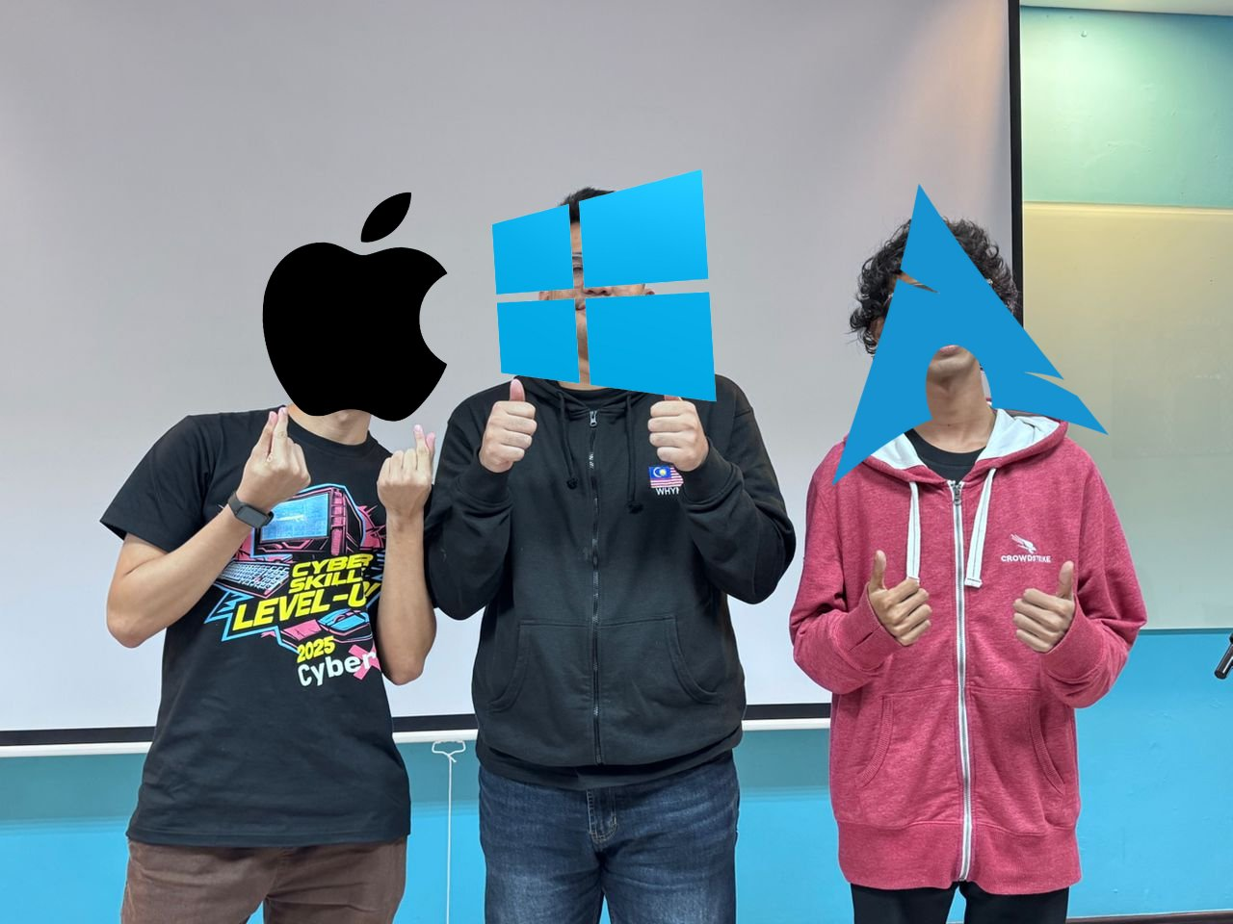
% whoami
Marcus Chan
Computer Science @ USM (“previously”)
I play CTFs at RE:UN10N :D

Slide 5

Why should I even care?
Good to know how your tools work and how to customize them to your workflow
Some assessments may not be possible
Business logic that gets in your way of testing

Slide 6
Example Scenario (Signed requests)
Commonly used for payment-related API requests
Application requires hash of your request body to be set in a header
This means if we modify any parts of the body, our request will get rejected if we don’t calculate a new hash
At this point, you’re stuck 🗿
Ref:https://docs.developer.paynet.my/docs/duitNow-online-banking-wallets/integration/security-&-encryption/message-signature/JSON-web-signature

Slide 7

Couple of Solutions
Manually generate the hash for each new request 💀
Write a python script to do calculation then using requests
PROBLEMS:
Tedious, and it gets annoying very fast
Both methods are very slow…
You can’t use any of your other tools in Burp, sqlmap, brute forcing, etc.

Slide 8

Introducing Burp Montoya API
The HttpHandler interface allows us to manipulate all HTTP requests to Burp (burp.api.montoya.http.handler)
This allows us to proxy requests from other tools to Burp to calculate the appropriate headers
Very simple, we only need to implement 2 methods
Can write in Python (Jython), R (Jruby), Java

Slide 9
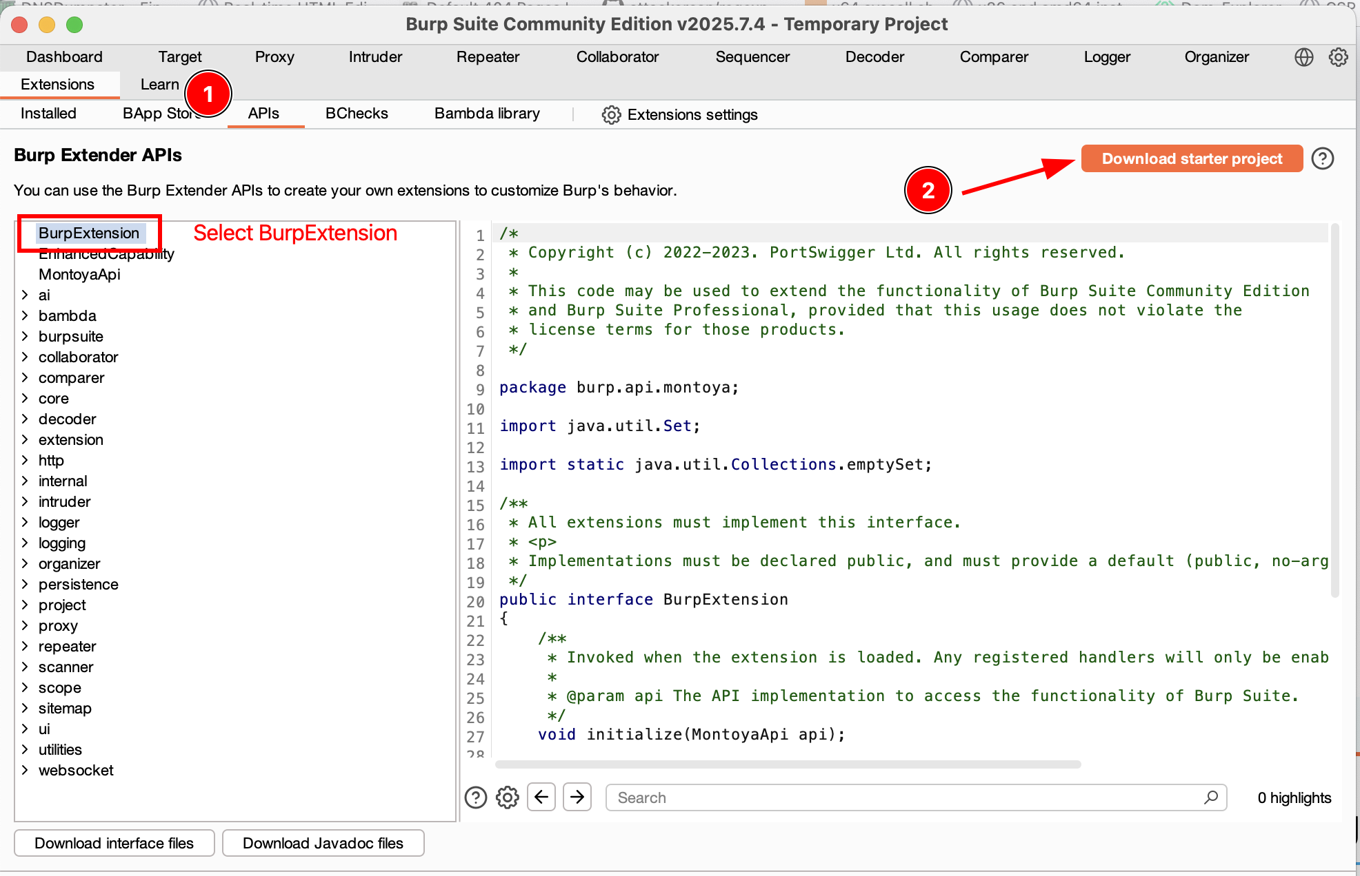
Then you can import the project to your favourite IDE/editor

Slide 10
Our HelloWorld!
Simple signing algorithm
Link to web app source code here
Validation steps:
Check if Signature header is set
Get request body then hash with SHA256
Compare Signature with calculated hash
Forward request if match, else reject
https://github.com/benkyousec/writing-your-first-burp-extension/tree/main/helloworldv1-api

Slide 11

That was easy enough
Now let’s add more complexity :>

Slide 12
HelloWorld v2
All requests must set the Timestamp, Ref, and Signature custom headers
Timestamp must be within 10 second timeframe when server receives the request.
Each request must have a unique Ref header value. For example, TESTER000000000 to identify the person assigned, and 9 digits for tagging
Each request must be signed and set its calculated value in the Signature header.
https://github.com/benkyousec/writing-your-first-burp-extension/tree/main/helloworldv2-api

Slide 13
Our “improved” signing algorithm
Header: {"alg":"HS256","typ":"JWT","uri":"/API-ENDPOINT-HERE","iat":"02052024133409"}
Timestamp in ddMMyyyyHHmmss format. Also need to update uri for each endpoint. Header must also be minified.
Payload:
{“id”:”1”,”amount”:”4”,”recipient”:”user@example.com”}
Payload must also be minified

Slide 14
Cont.
SigningInput = Base64(Header).Base64(Payload)
Signature = HS256(SigningInput, SECRET_KEY)
Set Signature header : Base64(Header).Base64(Payload).Base64(Signature)
https://github.com/benkyousec/writing-your-first-burp-extension/tree/main/helloworldv2-extension

Slide 15
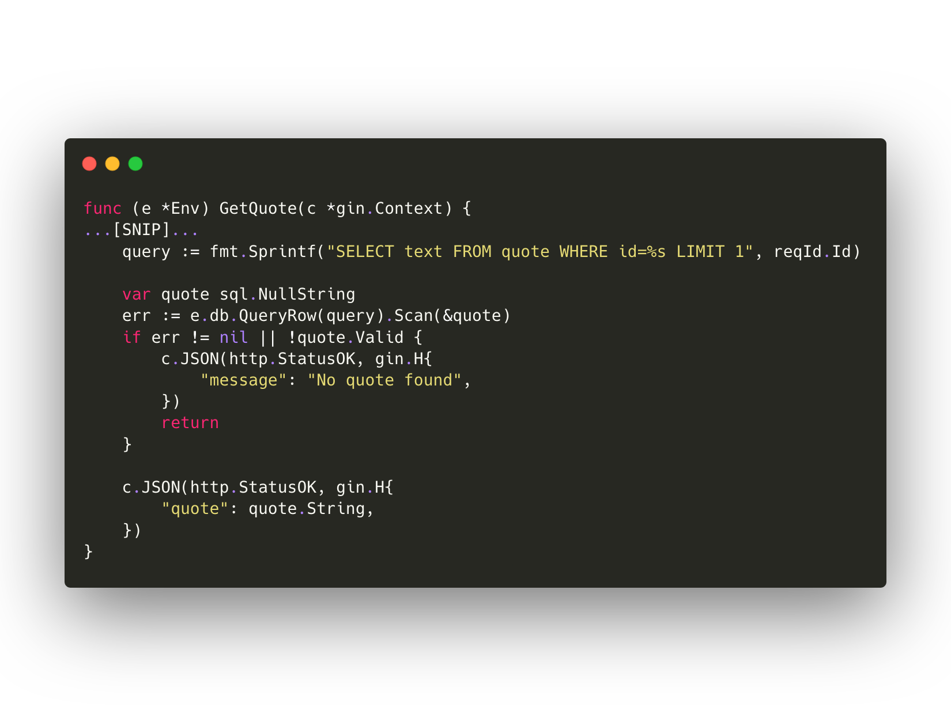

Slide 16
Some tips from my experience
Always read the documentation.
If you use a JWT library it may give you unexpected results when the API uses a very custom algorithm. You should implement it yourself.
Unless the feature you need for your extension is very simple, I’d suggest writing in Java.
If you deal with Base64 encoding, double check if it’s standard Base64 (uses +, / ) or Raw Base64 (uses -, _)

Slide 17

References
https://docs.developer.paynet.my/docs/duitNow-online-banking-wallets/integration/security-&-encryption/message-signature/JSON-web-signature
https://portswigger.github.io/burp-extensions-montoya-api/javadoc/burp/api/montoya/MontoyaApi.html

